Slide 1
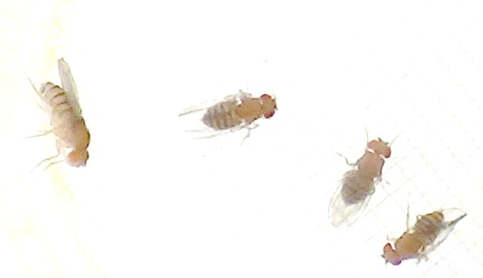
Different tracking software available and my experience with them

Slide 2
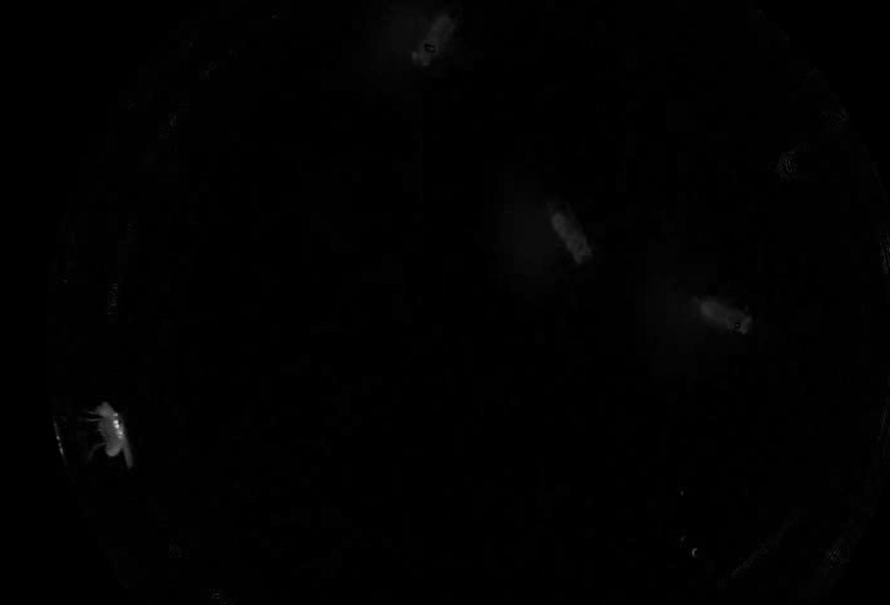
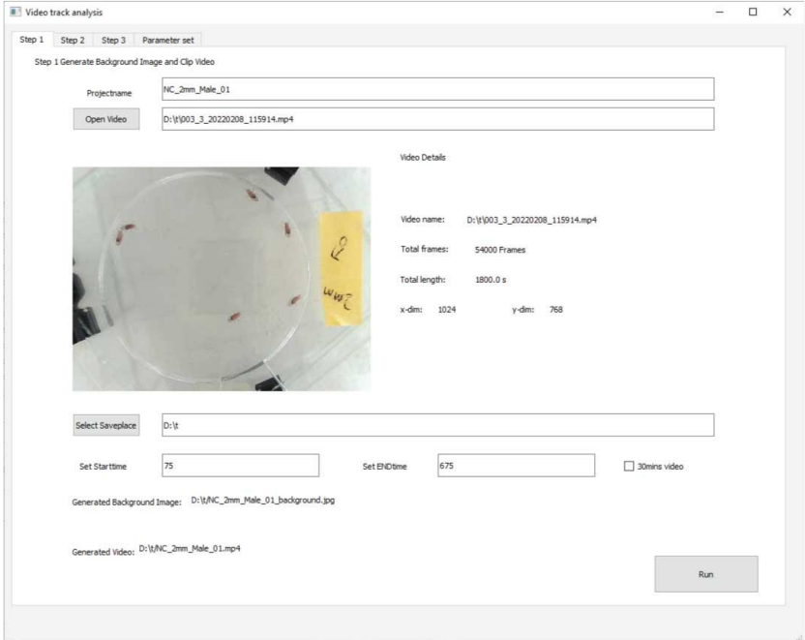
DVT Pipeline Method
step 1: Video prep (background removal)
Software used in DVT analysis
• GIMP- Image Manipulation Program
• PotPlayer x64 210318
• UMATracker x64 Release 14
Pros:
Easy steps to remove background
No ghost flies.
Cons:
Required mp4 conversion;
Very Slow
Wrong aspect ratio
Dark video
Need to alter contrast! – changed background
Mi, K., Li, Y., Yang, Y. et al. DVT: a high-throughput analysis pipeline for locomotion and social behavior in adult Drosophila melanogaster. Cell Biosci 13, 187 (2023). https://doi.org/10.1186/s13578-023-01125-0

Slide 3
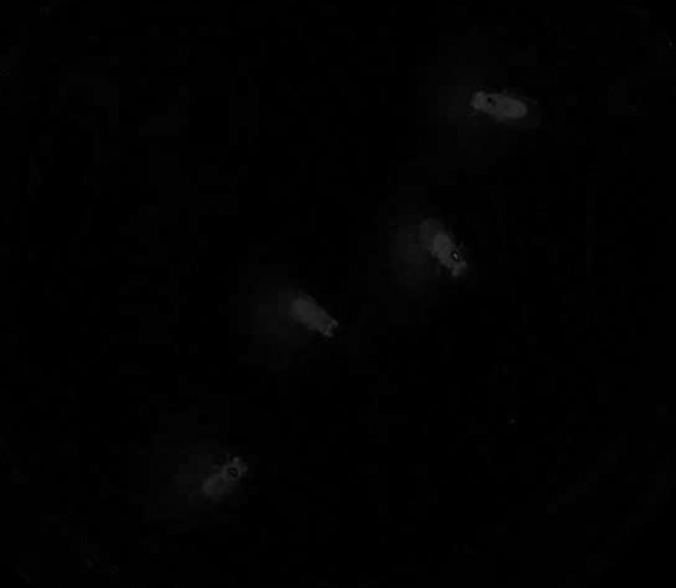
Low contrast is an issue

Slide 4
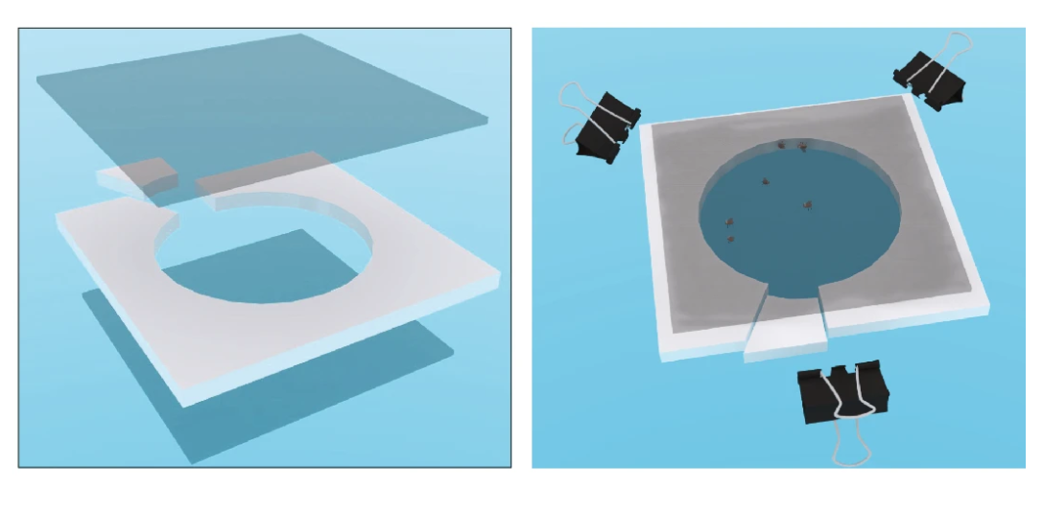
Data suggests:
compared with flies in 3 mm-height chambers, the social networks of flies in 2 mm-height chambers tended to be smaller and less connected, with fewer number of nodes.
In 2mm chamber, there is a greater restriction in movement for larger female flies.

Slide 5
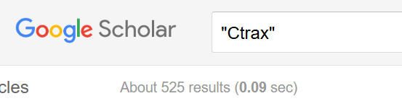
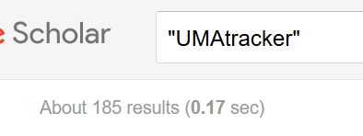
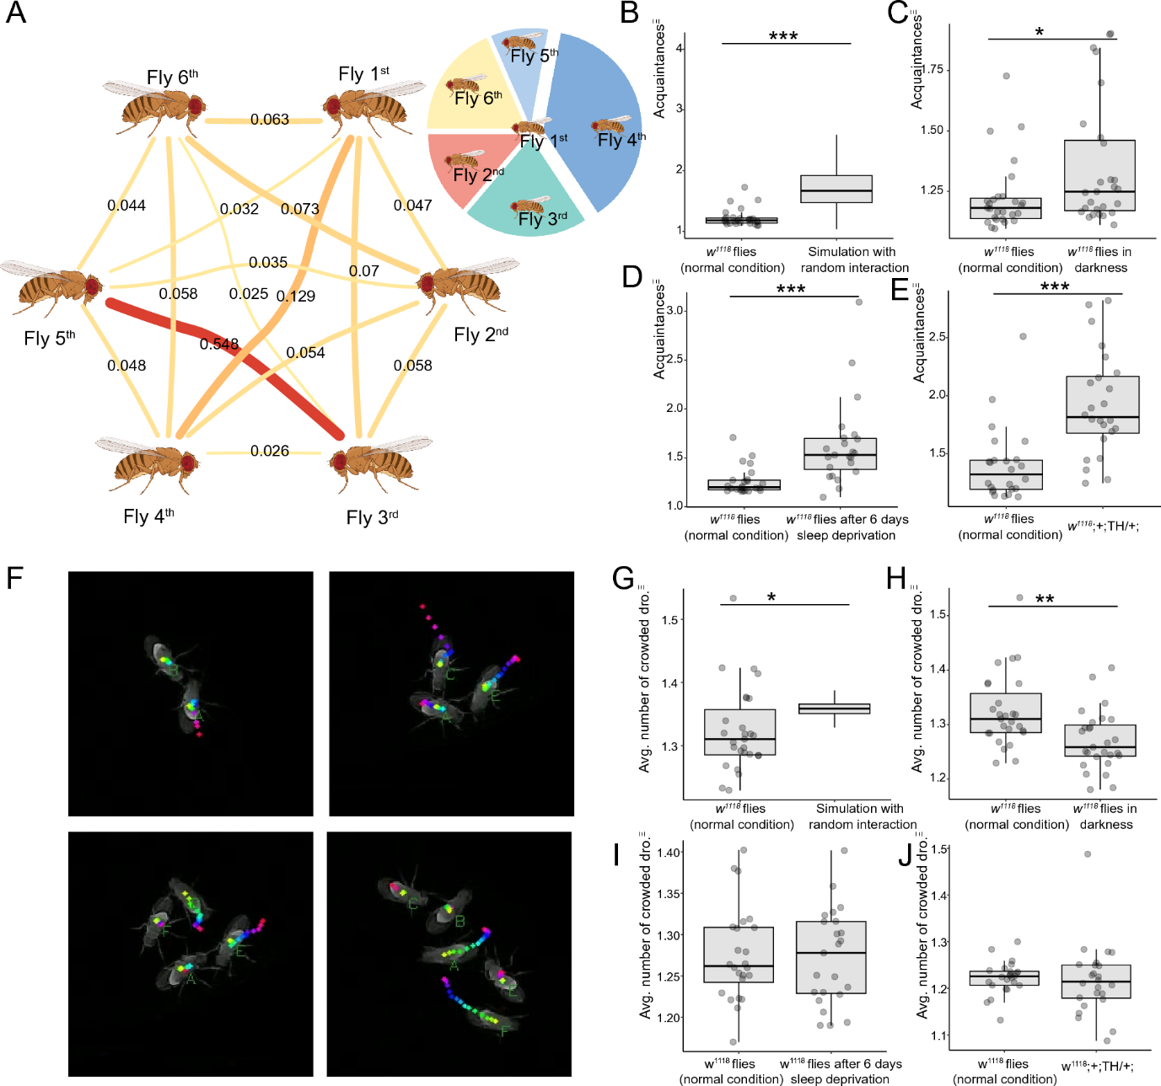
Ctrax or UMATracker?
Number of publications – pubmed 7 vs 2; GS 429 vs 41 with “Drosophila”
Amount of resources available
Programmes required and size - matlab vs python
Fly specific vs general use
Video footage requirements FMF vs mp4
Mi, K., Li, Y., Yang, Y. et al. DVT: a high-throughput analysis pipeline for locomotion and social behavior in adult Drosophila melanogaster. Cell Biosci 13, 187 (2023). https://doi.org/10.1186/s13578-023-01125-0
If the trace is generated by other software, make sure the trace file has the same data definition as UMATracker.

Slide 6
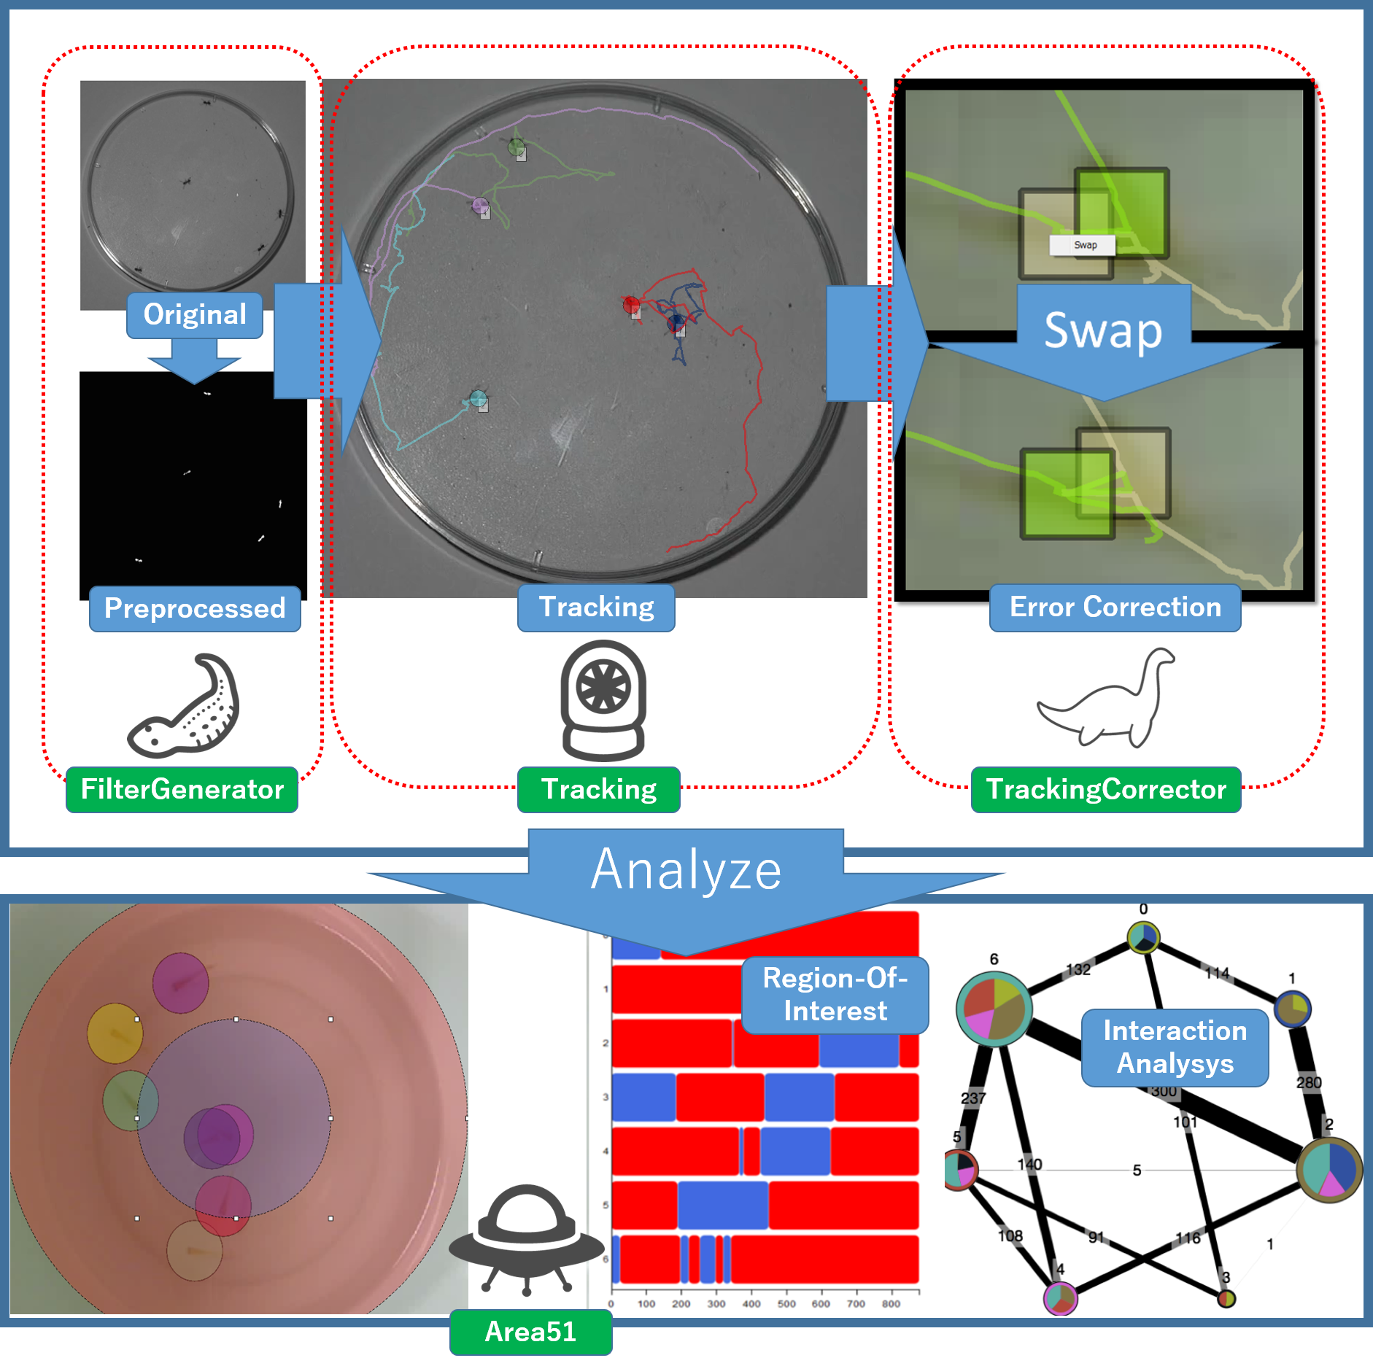
Option 1: UMATracker
4 step process:
UMATracker-FilterGenerator: Create a filter for the video pre-processing.
UMATracker-Tracking: Perform individual tracking using a filter that you created in the UMATracker-FilterGenerator.
UMATracker-TrackingCorrector Correct the individual tracking results obtained with UMATracker-Tracking.
UMATracker-Area51 Analyse the tracking result.
https://umatracker.github.io/UMATracker-manual-en/_md/quick_ref.html
Notes:
https://umatracker.github.io/UMATracker-manual-en/_md/quick_ref.html

Slide 7
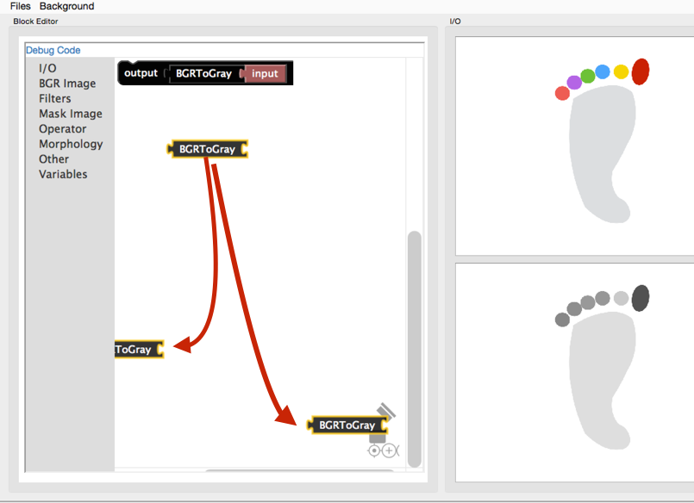
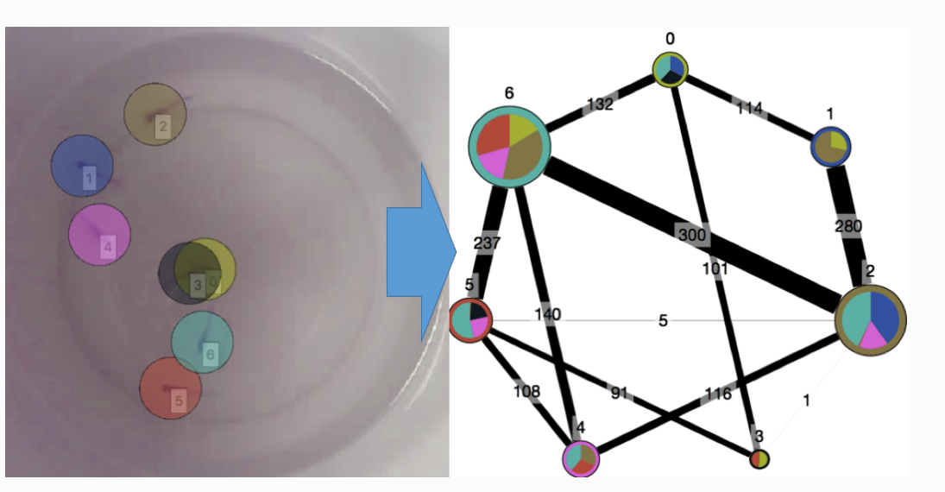
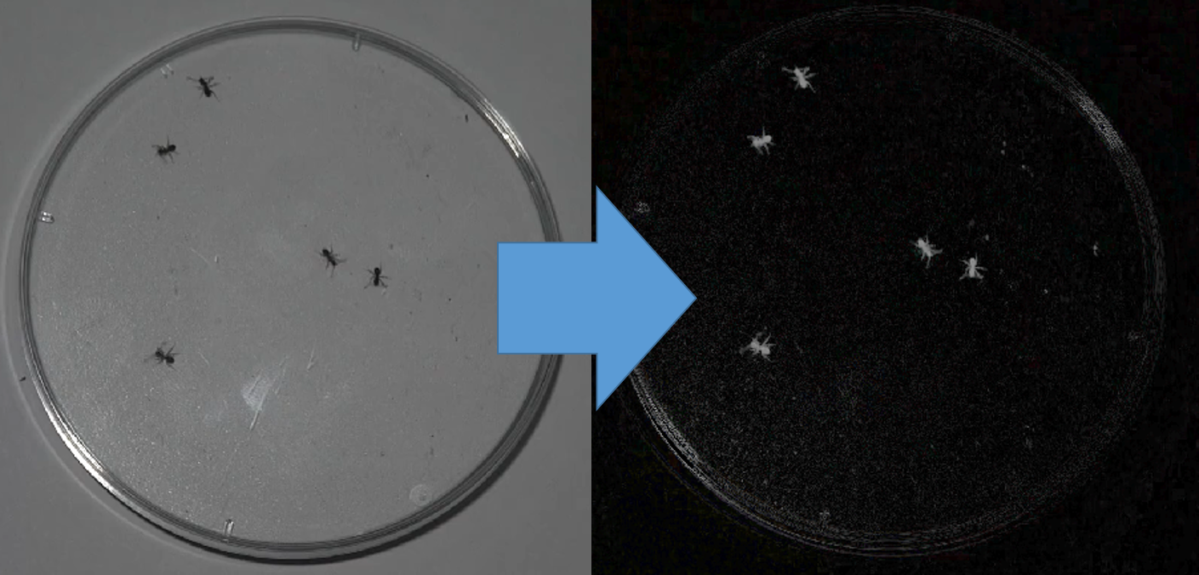
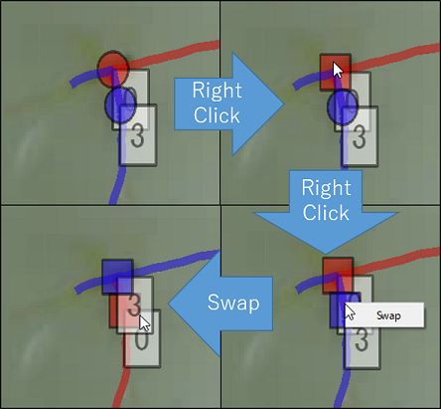
(above)
based on the distance between each individual.
Way to filter animals with coloured marker
Notes:
Way to filter animals with coloured marker
https://umatracker.github.io/UMATracker-manual-en/_md/quick_ref.html#data-analysis

Slide 8
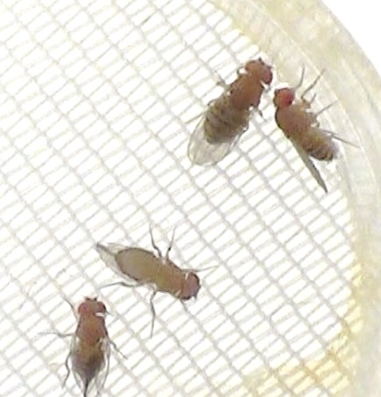
Option 2: Ctrax
Pros:
Simple steps to process video
Lighter video with more contrast
Easy install
Cons:
Ghost flies more common
Background removal process struggled with mesh
Not for all aspect ratios
Struggled to correctly identify flies
Not dynamic

Slide 9
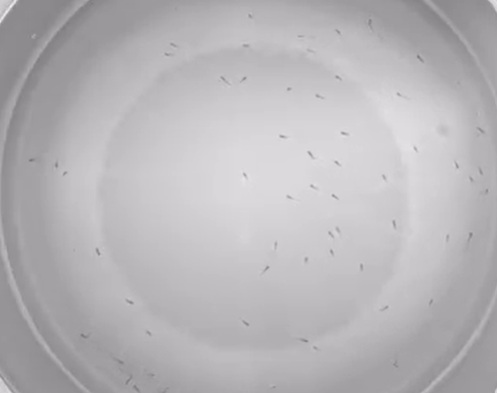
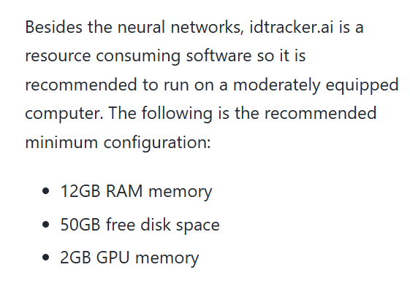
Option 3: Idtracker.ai
Pros:
Simple steps
No ghost flies.
Lighter video with more contrast
Faster background removal
Works for all aspect ratios
Immediately able to access tracking steps – required adjustment of parameters to best identify correct number of blobs.
Cons:
Resource consuming software
Currently difficult to run on the HPC
Better with GPU; can use CPU.
Running with identities takes ~4 Hrs / 7 min video

Slide 10
Note difficult to run on the HPC:
Emailed HPC staff - in contact with Andrew Baughan, UEA.
Learnt how to put my data on the HPC.
Gained required access to GPU resources.
Met with Jacob Newman to compare UMATracker method with idtracker.ai.
Works well on sufficient laptop

Slide 11
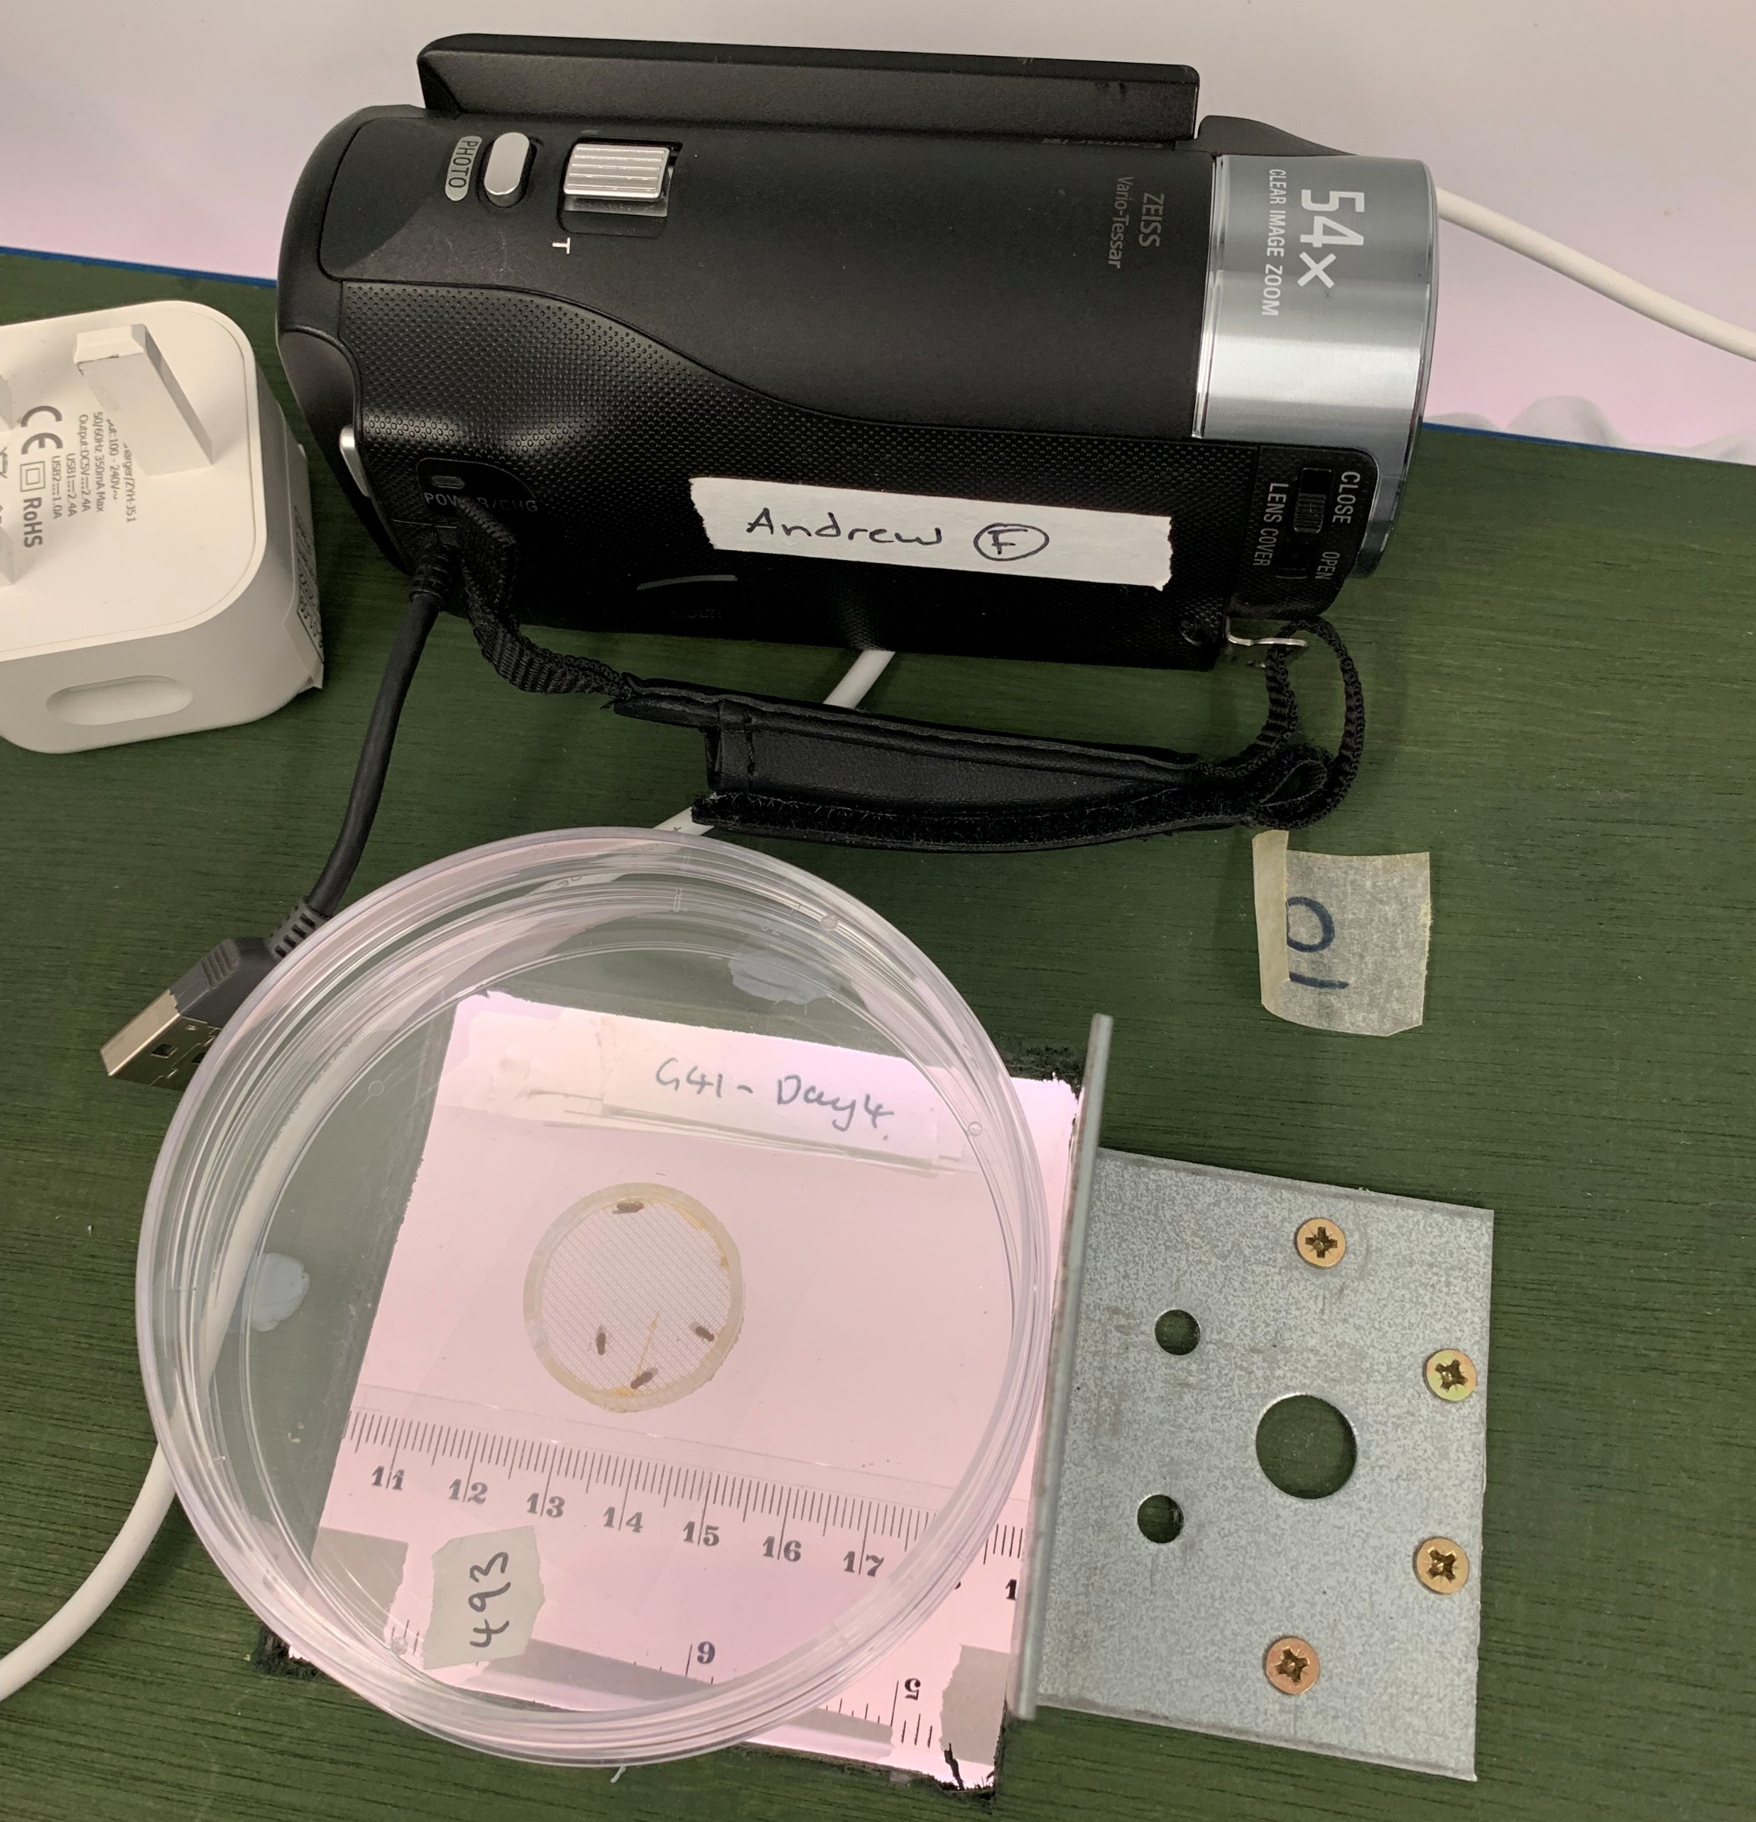
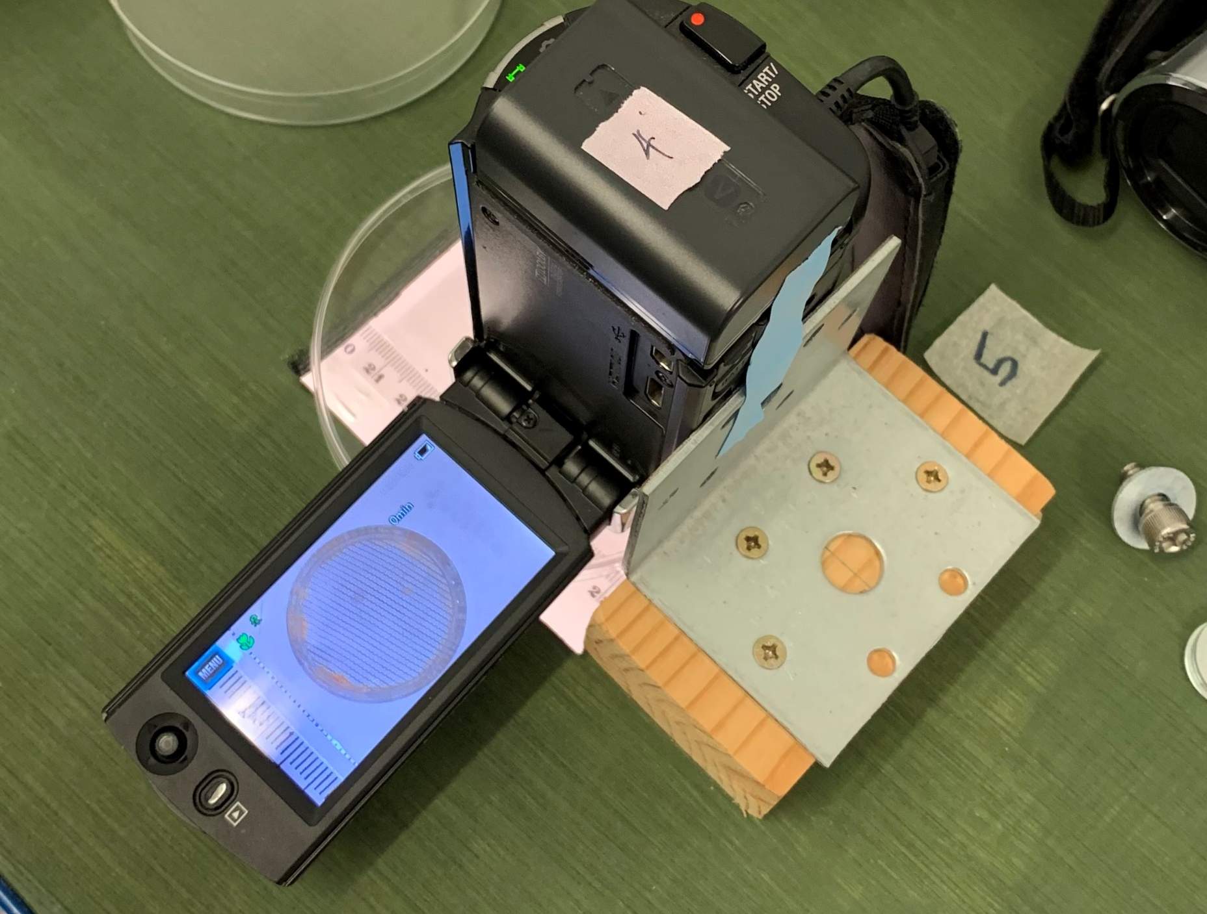
My setup and progress:

Slide 12
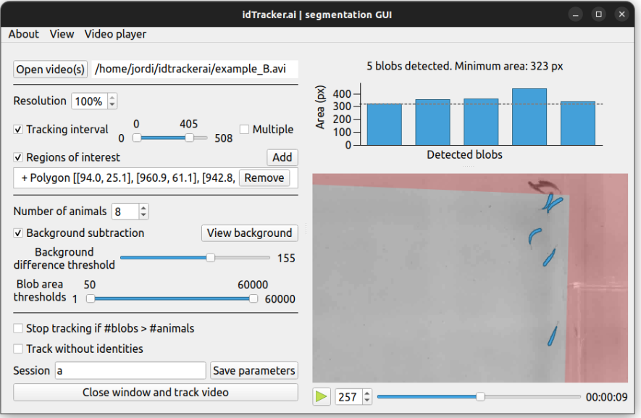
My setup and progress:

